Slide 1

INGLÉS PARA EL TRABAJO
Tema 9: There was and there were
Todas las carreras

Slide 2
Describe un lugar en el que estuvo formulando oraciones y preguntas utilizando there was / there were en afirmativo, negativo y yes/no questions.

Slide 3
TEMA 9: There was and there were
SUBTEMAS:
Review of there is and there are
There was and there were

Slide 4
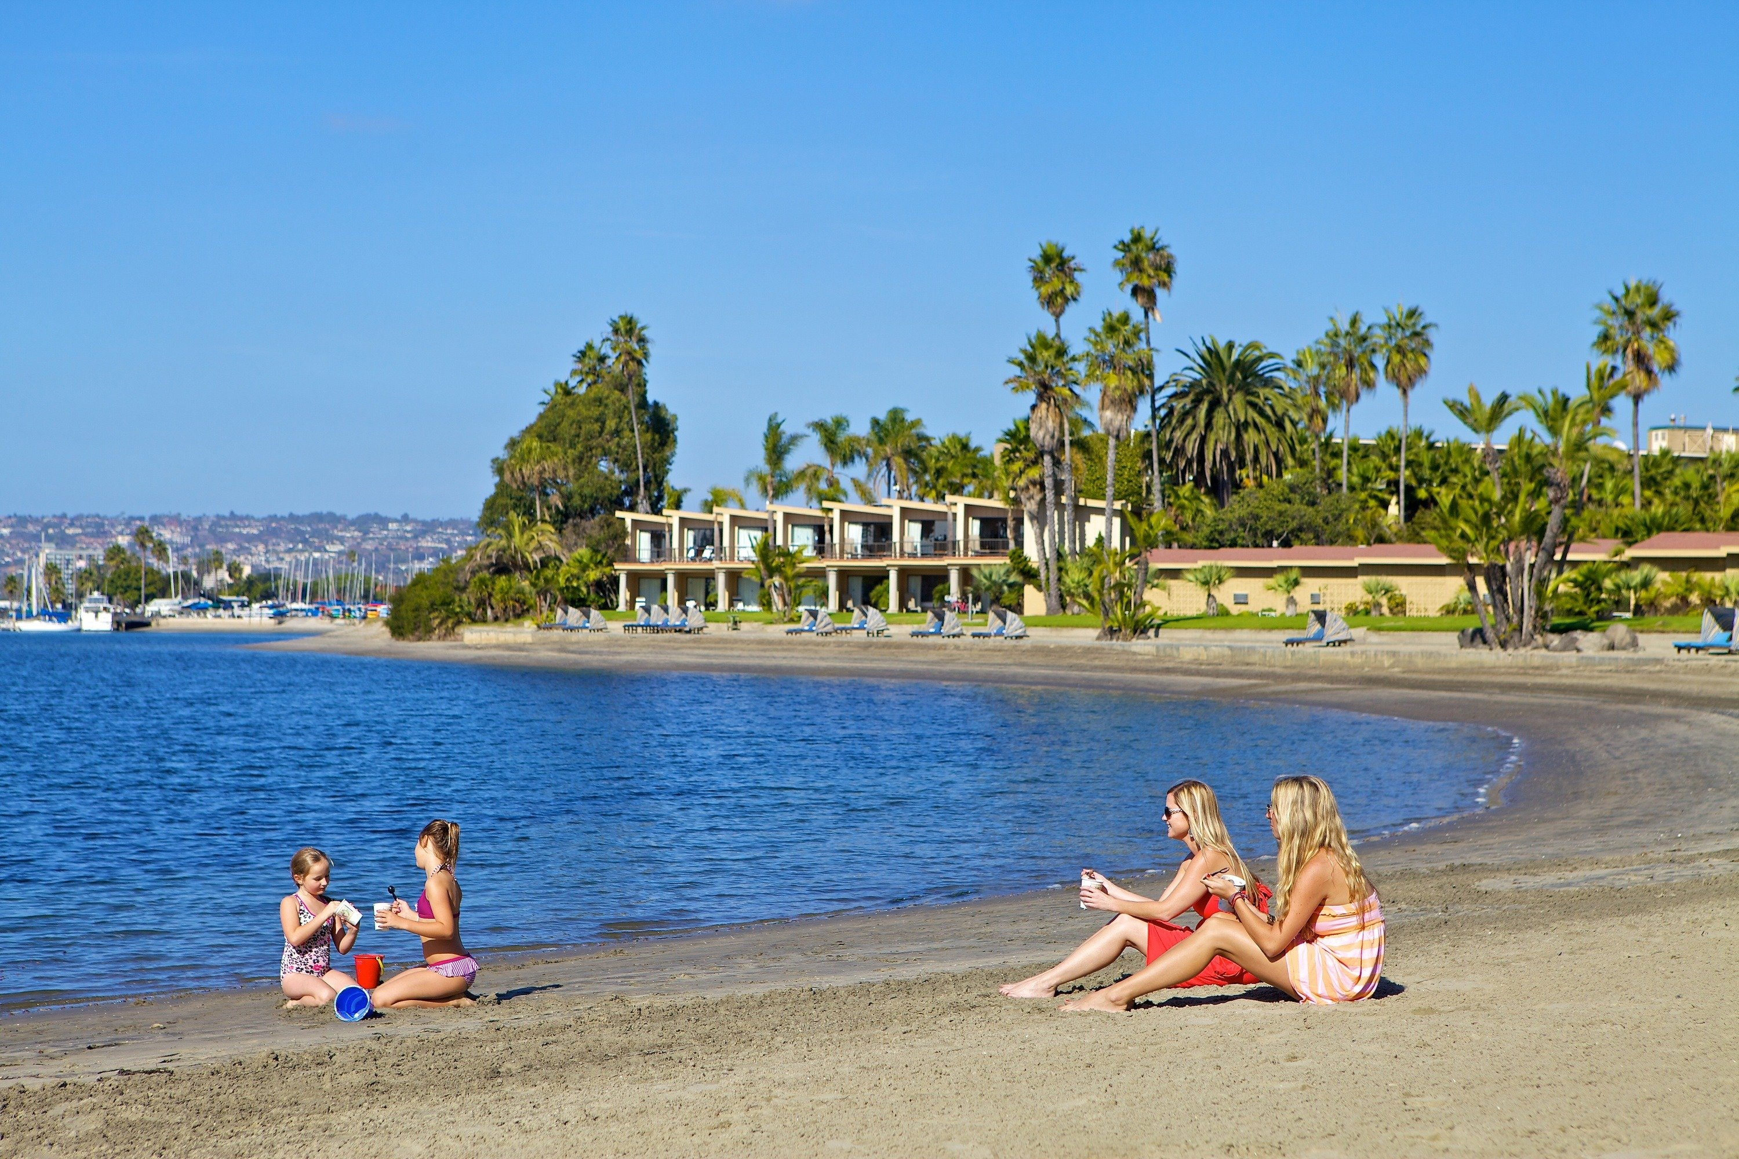

Inglés para el Trabajo
Review of there is and there are
Look at the picture and answer:
What can you see?

Slide 5
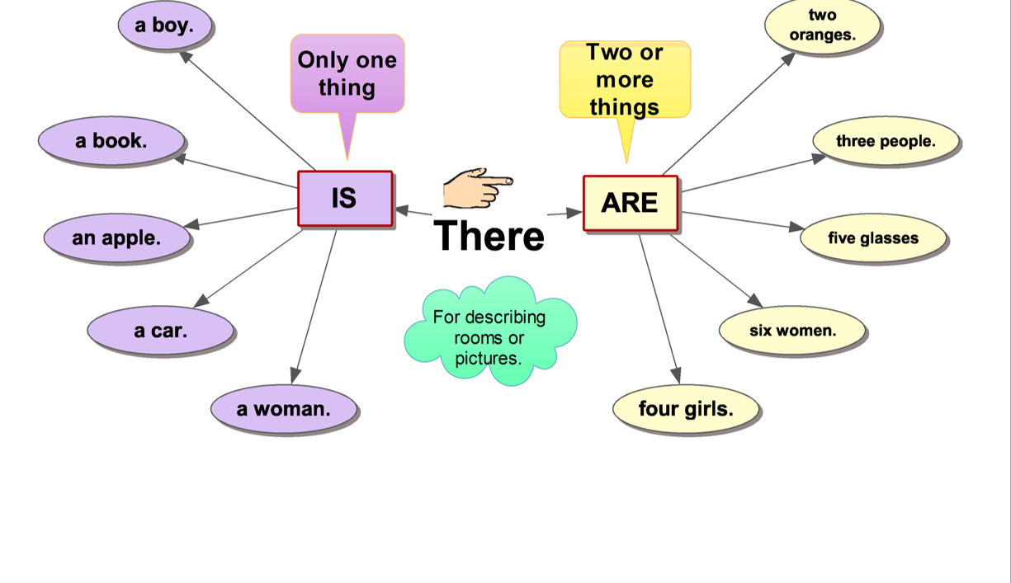

Inglés para el Trabajo
Review of there is and there are
We use there is and there are to describe rooms or your favorite places.

Slide 6
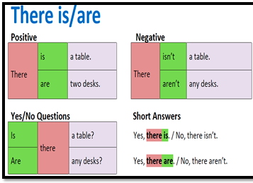
Inglés para el Trabajo
Review of there is and there are
We use there is and there are in these forms:

Slide 7
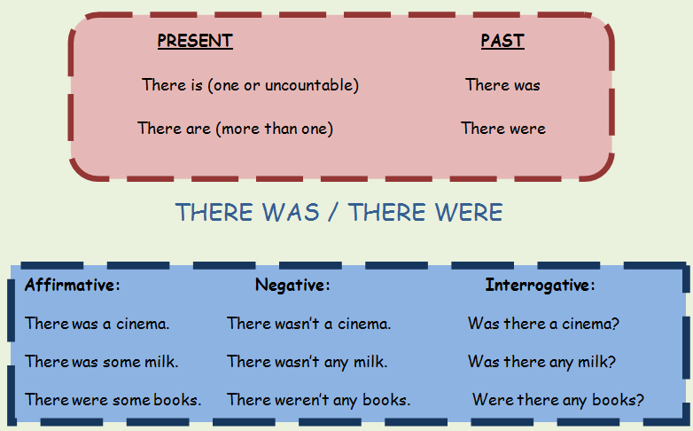
Inglés para el Trabajo
There was and there were
When you describe places you visited in the past ,we use there was and there were.

Slide 8
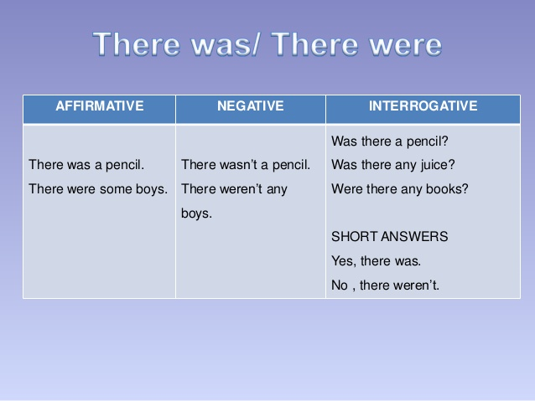
Inglés para el Trabajo
There was and there were
We use there was and there were in these forms:

Slide 9
Inglés para el Trabajo
There was and there were
We use there was and there were in this form:

Slide 10
Virtual Activity

Slide 11
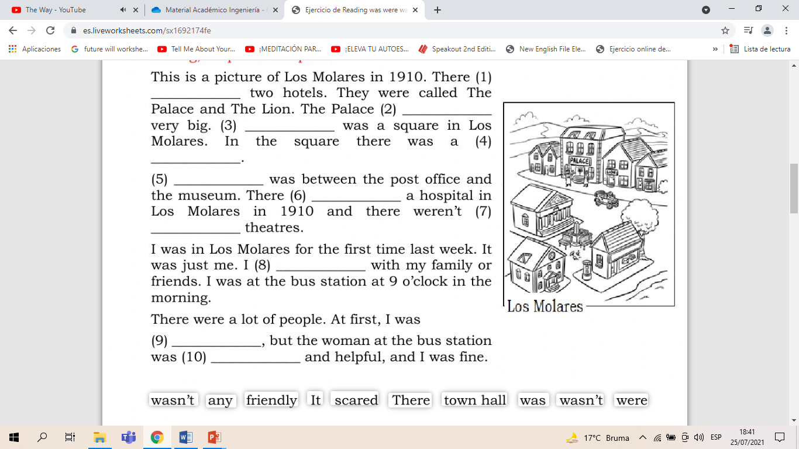
Inglés para el Trabajo
Virtual Activity
Read and complete the text with the words below.

Slide 12
Thanks!

